Slide 1

Word Guessing Game Overview
Notes:
This slide introduces the Word Guessing Game, explaining its core concept and gameplay mechanics. It highlights the educational benefits such as vocabulary enhancement and strategic thinking. The game is versatile, allowing solo or group play, with adjustable difficulty and hints to keep players engaged.

Slide 2
Welcome to the Word Guessing Game
An engaging and interactive word guessing challenge.
Test your vocabulary and deduction skills.
Designed for all age groups to have fun and learn.
Simple rules make it easy to start playing quickly.
Notes:
This slide introduces the Word Guessing Game, highlighting its appeal as an exciting and educational activity suitable for players of all ages. The focus is on vocabulary skills and logical deduction, making it both fun and mentally stimulating.

Slide 3

How to Play the Game
Players try to guess a hidden word letter by letter.
Each correct guess reveals the letter's position(s).
Incorrect guesses reduce the number of attempts left.
The goal is to guess the word before running out of attempts.
Notes:
This slide explains the game mechanics, emphasizing the process of guessing letters, revealing correct guesses, and managing limited attempts. Understanding these rules is key to enjoying and succeeding in the game.

Slide 4

Game Features and Benefits
Enhances vocabulary and spelling skills.
Improves problem-solving and critical thinking.
Offers different difficulty levels for all players.
Encourages friendly competition and social interaction.
Notes:
Here, the slide explores the educational and social benefits of the Word Guessing Game. It fosters language development, cognitive skills, and provides an enjoyable platform for friendly competition.

Slide 5

Getting Started with the Game
Choose your difficulty level to match your skill.
Select a game mode: solo or multiplayer.
Start guessing letters and enjoy the challenge.
Keep track of scores and try to improve each time.
Notes:
This slide guides new players on how to begin playing the Word Guessing Game, from selecting difficulty and mode to engaging in gameplay. It encourages continuous improvement and enjoyment.

Slide 6

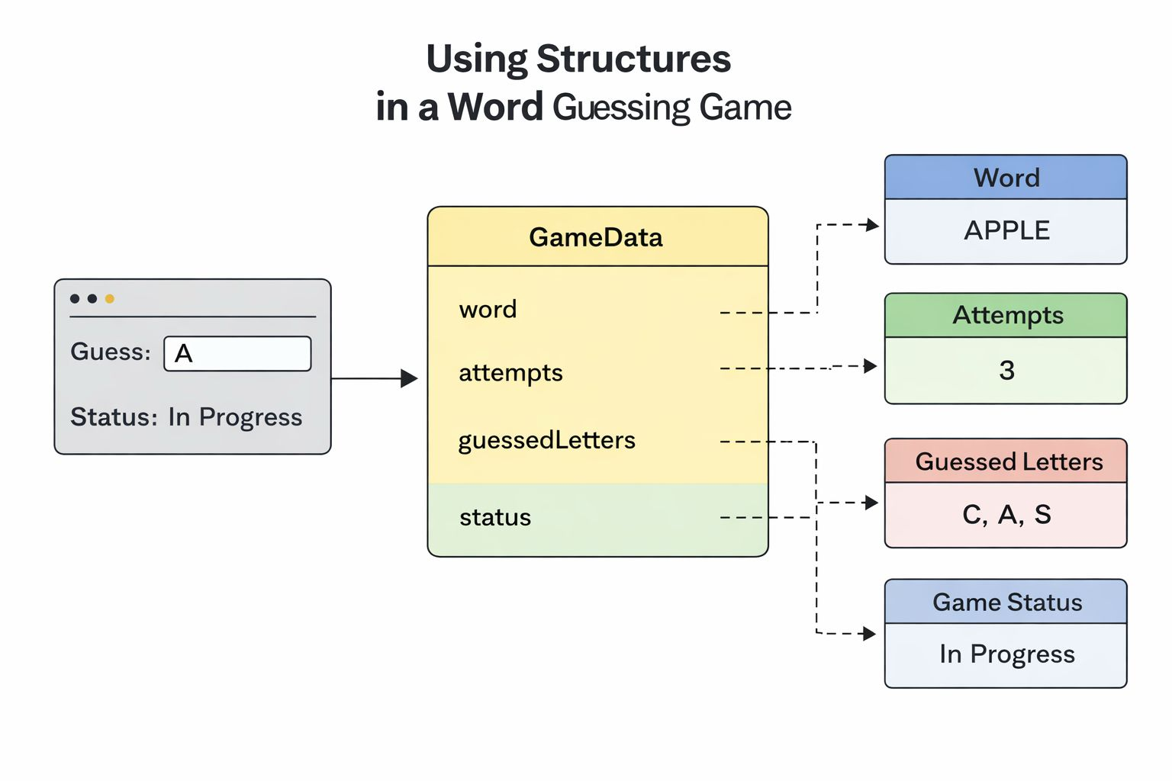
Using Structures in the Word Guessing Game
Structures organize related game data into meaningful groups.
Store word, guessed letters, attempts, and game status together.
Facilitates easy management and passing of game data.
Improves code clarity and maintainability.
Notes:
Structures in C allow grouping different variables related to the word guessing game, such as the secret word, guessed characters, number of attempts, and the current game status. This helps keep the game data organized and makes the code easier to manage and understand.

Slide 7
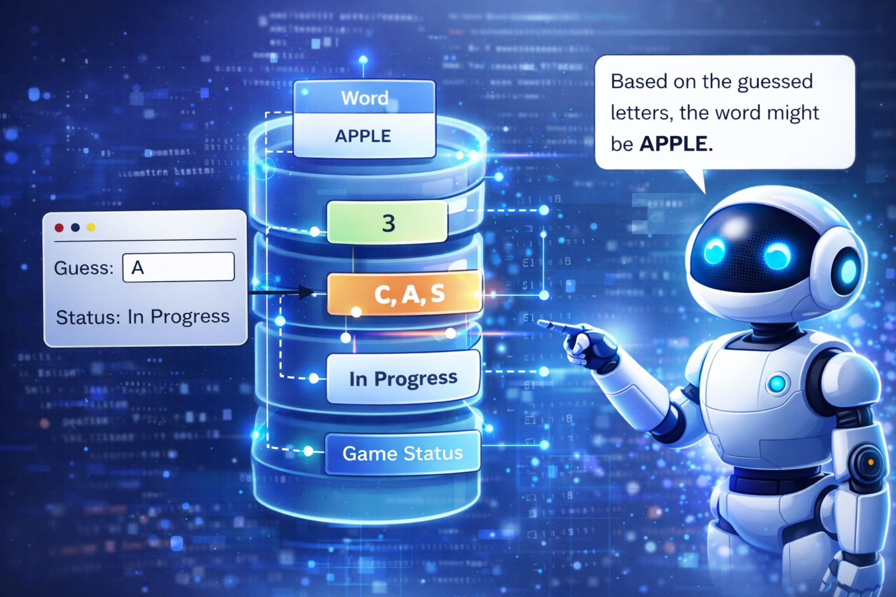
Pointers for Dynamic Data Handling
.
Pointers enable dynamic memory allocation for variable-length words.
Used to access and modify characters in the secret word.
Efficiently handle strings and arrays in the game.
Essential for passing game data between functions.
Notes:
Pointers in C are used in the word guessing game to dynamically allocate memory for words of varying length. They allow direct manipulation of characters in the word and facilitate passing data between functions without copying large amounts of memory.

Slide 8

How Loops Enhance the Word Guessing Game
Loops allow repeated guessing attempts until word is guessed or tries are exhausted.
For loops iterate over each character to check if guessed letter matches.
While loops control the game flow based on remaining attempts.
Loops simplify input validation and updating game state dynamically.
They enable efficient processing of player inputs and word progress.
Notes:
Loops are fundamental in the word guessing game C program as they manage repeated actions such as checking each letter of the secret word against player guesses. For loops traverse the word characters, while while loops maintain the game running as long as attempts remain. This repetition control ensures smooth gameplay and dynamic updates of the game state, making the program efficient and user-friendly.

Slide 9
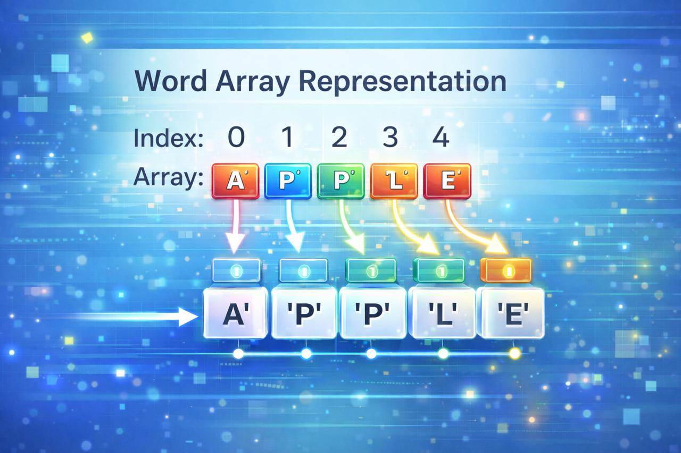
Role of Arrays in Word Games
.
Arrays store letters making up the secret word efficiently.
Enable easy checking and updating of guessed letters.
Support dynamic word length handling in various difficulty levels.
Facilitate iteration to reveal correct guesses sequentially.
Simplify management of player inputs and game progress.
Notes:
Arrays are fundamental in word games as they hold the characters of the secret word and track guesses. By using arrays, the game can easily check which letters have been guessed and update the display accordingly. Arrays also allow handling words of different lengths and simplify processing player inputs for smooth gameplay.

Slide 10

Team Members:
K Nandini(25A31A04D7)
K Greeshma(25A31A04D8)
D Varun (25A31A04G8)
G Manisankhar (25A31A04G9)

